Slide 1
Community Grants Training
27 Jun 2023

Slide 2
Congratulations on your award! This presentation is to understand what Douglas County expects from the you, the awardee and what the awardee can expect from us, the funder.

Slide 3
There have been a few improvements this year to reduce any confusion as to what will be required and how to receive your awarded funding. Douglas County wants your project to be a successful pleasant experience and hopefully this training will be the first step! We will go over: Required Documents Reimbursement Reporting Grant Close Out Questions

Slide 4
Required Documents If you are attending this training your organization has received an award agreement. Please complete the information requested, sign and return to Douglas County Grants Administrator, Inbox - Community Grant Community_Grant@douglasnv.us. Once the County manager signs, a copy will be returned to you. A current W-9 was requested. This is a requirement each time an award is approved. If you are not an existing vendor with Douglas County, a vendor information form will need to be completed. Will you have a secondary remit address? We will need a vendor information form to reimburse your agency. If you are a non-profit and have a tax-exempt status, a copy of your tax-exempt form will be required so a 1099-G will not be created at year end. Once all requirements have been completed, your agency will be able to request reimbursement of funds.

Slide 5
Reimbursement Once you have purchased your allowable item send your organizations invoice along with proof of payment & copy of original invoice, timesheet, backup documents to Inbox - Community Grant Community_Grant@douglasnv.us. A purchase order will be created for each of your projects. The purchase order number needs to be on your invoice. This will be a way to track how much is remaining on your project so you don’t go over budget. If you are being reimbursed for wages, a timesheet or report showing the person’s name, hours worked signed off by their supervisor and proof of payment is required. Requests for advance of funds cannot be honored. If you are purchasing an item and advance purchase is required, then that would be a reimbursable request. Prior approval from Douglas County will be required for all pre-payments. Same information would be required, invoice, backup and method of payment. Watch your dates for reimbursement. No purchase(s) done after 30 Jun 2024 will be reimbursed. Final date to submit an invoice for reimbursement is 31 Jul 2024. Will you have a secondary remit address? We will need a vendor form for this information. Your invoice will be processed as soon as received if all the required documentation is submitted.

Slide 6
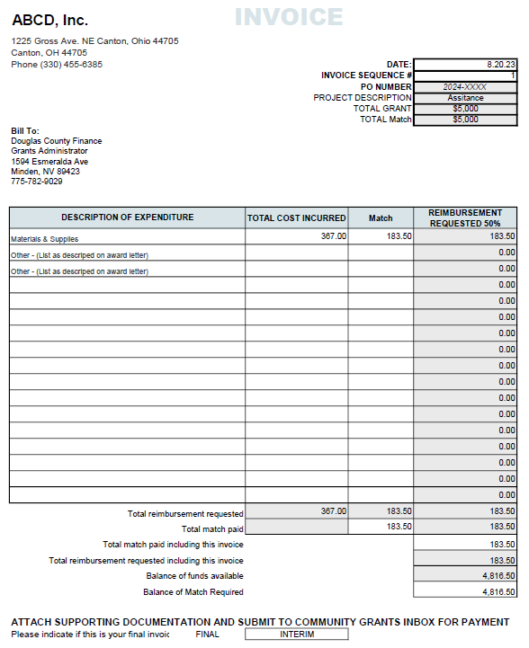
Reimbursement
All documents must be in a PDF format.
No JPEG documents can be accepted.

Slide 7
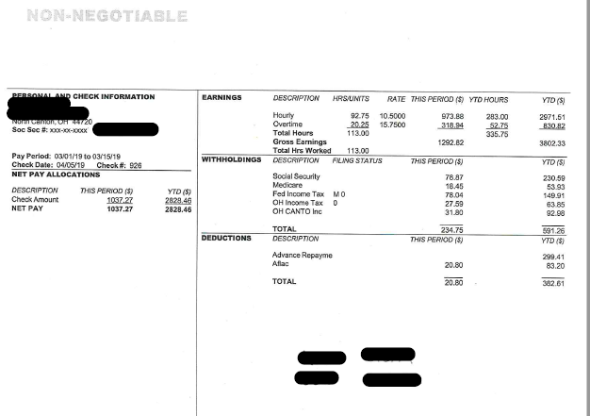
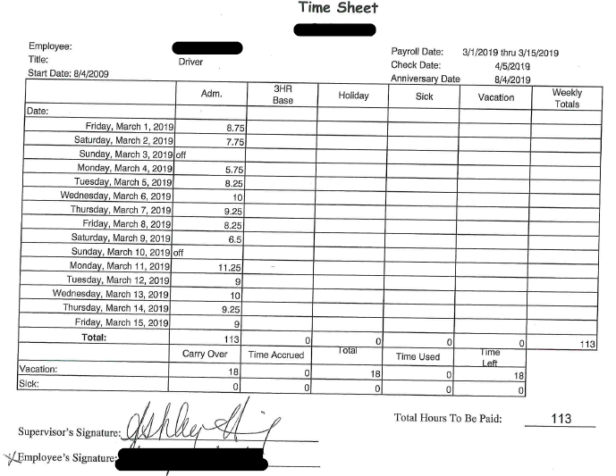
Reimbursement Wages - Backup
Timesheets need to be signed
by a Supervisor.

Slide 8
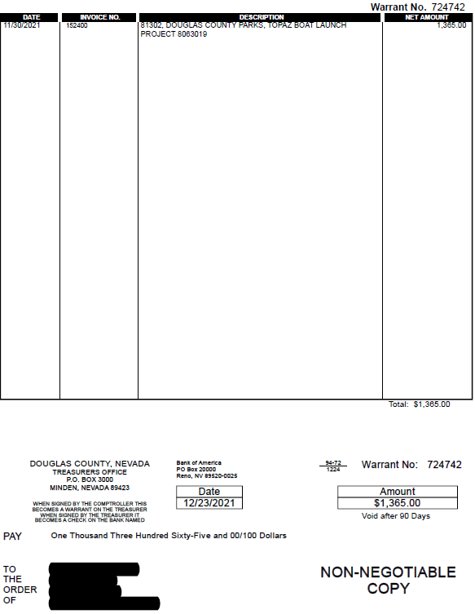
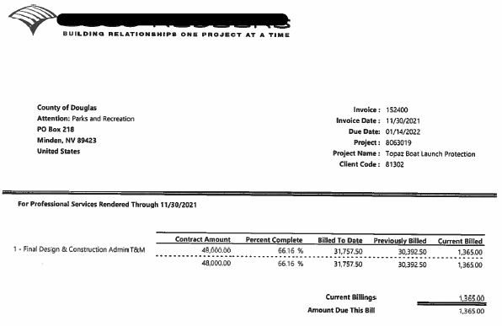
Reimbursement Backup – Invoice with check copy.

Slide 9
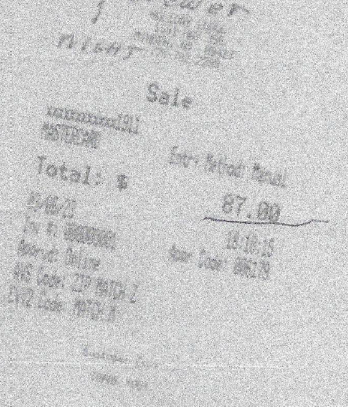
Reimbursement - Backup
All receipts need to be readable!
If you use a credit card the receipt
needs to show what was purchased. Non-detailed receipts cannot be accepted for reimbursement.
If the charge is on the agency credit card,
the credit card statement showing
the charge and payment of the credit
Card is required.

Slide 10
Reimbursement – Unallowable costs
Only items you have been awarded may be reimbursed.

Slide 11
Reimbursement – Backup for passes or give aways
For reimbursement for items given away… tickets, approved gift cards, raffles.
All backup needs to be readable!
All items given away must be recorded with the following information:
Printed name of the person receiving the item
Contact Information
Ticket/pass number, etc.
Date
Signature of person receiving item.
Forms can be supplied for your use.

Slide 12
Reimbursement – Backup
All backup needs to be readable!
Only backup for the items being reimbursed should be with your invoice.
Mark reimbursement item on credit card or bank statement. If there are several invoices that make up one payment make sure it is obvious. Highlight or mark items.
Have your invoice and backup make sense in the order you send.
Send all invoices and backup to Community_Grant@douglasnv.us

Slide 13
Reporting When your organization has exhausted its funding a report detailing the success you had will be required. How was the project successful? How many people did you help? If you have any demographic information please include. What was the impact of your program for Douglas County’s citizens? Your report is not just viewed by the grant committee regarding future funding but the information will be used to inform the community on how Douglas County funds were being utilized. Your report should paint the picture of when, where, why and how much it helped the Douglas County community. You know how it helped now transfer that information so others may know also. Reports are due on or before close of business 31 Aug 2024.

Slide 14
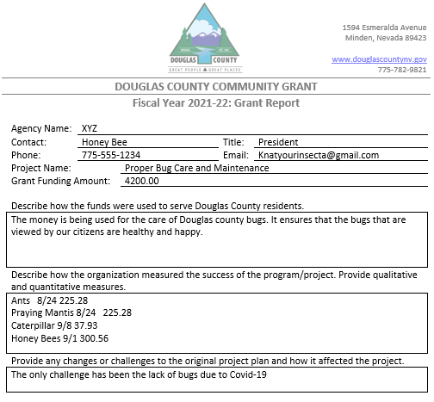
Reporting – Don’ts

Slide 15
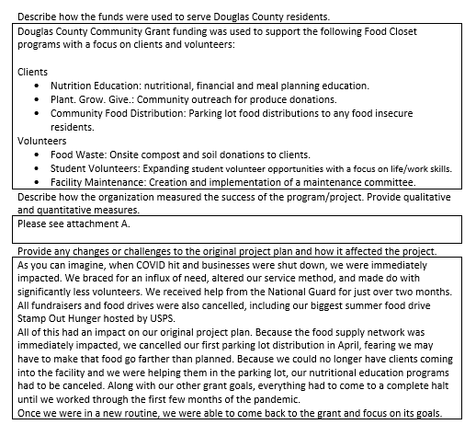
Reporting – Do’s

Slide 16
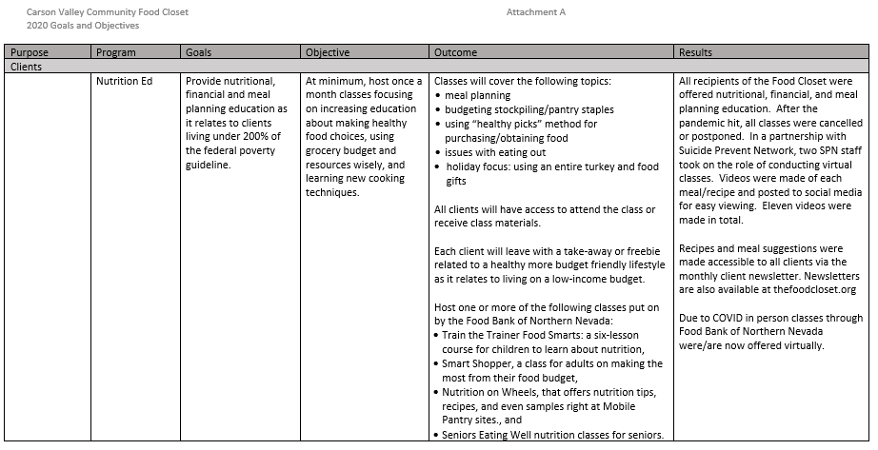
Reporting – Do’s

Slide 17
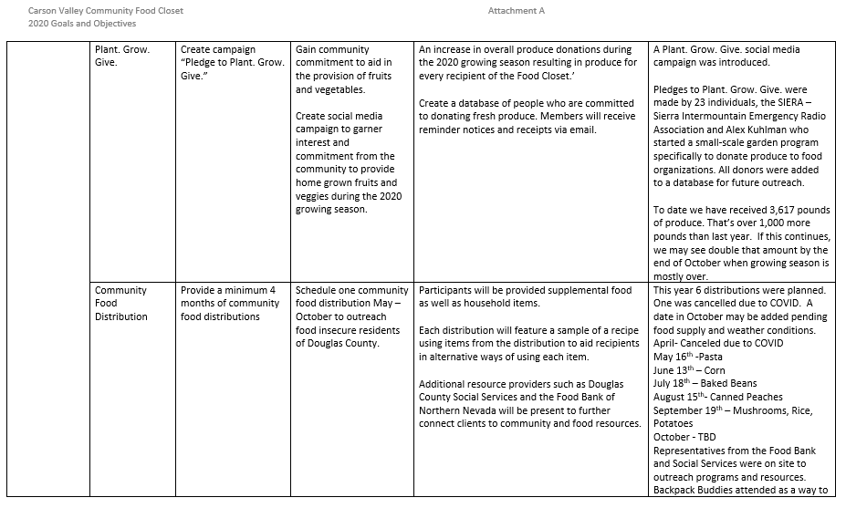
Reporting – Do’s

Slide 18
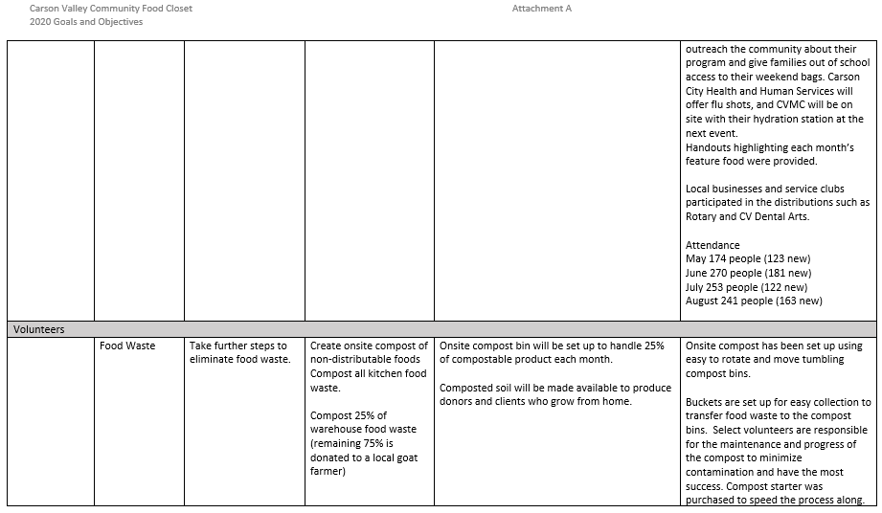
Reporting – Do’s

Slide 19
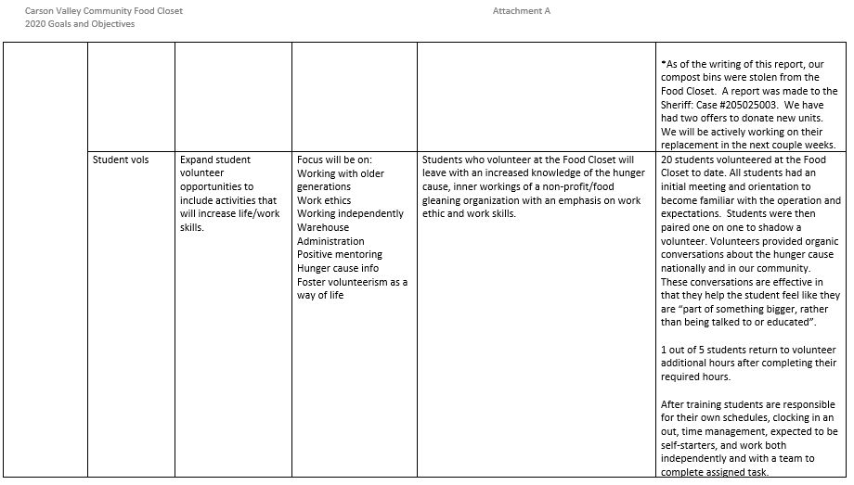
Reporting – Do’s

Slide 20
Reporting – Do’s
Your reports play a part in scoring for future funding opportunities. It’s all up to you!!!!

Slide 21
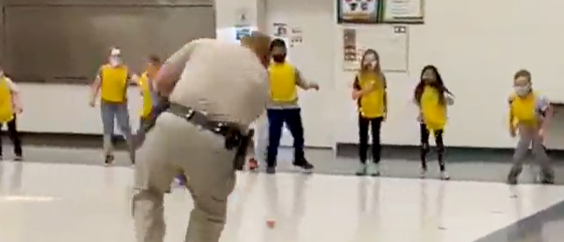
Close Out When your organization has exhausted its funding and your report detailing the success you had has been submitted a closeout letter will be supplied. A success story section is being added to the Community Grants website for Douglas County to view. During the course of your project take photos and send them to Inbox - Community Grant Community_Grant@douglasnv.us . Your photos and final reporting success stories will be added. We want to share that with the community!

Slide 22
If you have questions or need any assistance please contact: Community Grant - Debbie Swickard – Douglas County Grants Administrator 775-782-9029 dswickard@douglasnv.us

Slide 23
Questions?

Slide 24
Thank you!

